Slide 1
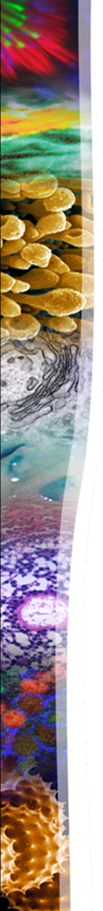


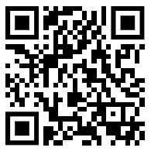



The 2026 Iowa Art in Science Contest!!
Image Submissions Due November 6th
The goal of The Iowa Art in Science Contest is to recognize the combination of outstanding scientific discovery and artistic appeal in research imaging. Images from any mode of microscopy can be used, and any form of colorization, manipulation and compositing is completely acceptable. Be creative, have fun!
Winning scientist-artists will receive prizes and 12 will have their art featured in the 2026 CMRF Calendar!
Submit one image and a description to Thomas-Moninger@uiowa.edu (QR code below) or any CMRF staff member
Submitted images may be used by the CMRF for promotional purposes.

